Slide 1
DSO 560 – Final Project Team Purple
KINDLE BOOK REVIEWS
AMAN AGARWAL
CHINMAYI BENGALURU PRAKASH
FALAK JAIN
NAVEEN KUMAR MANJUNATHA

Slide 2
Problem Statement
The Amazon Kindle reviews dataset is studied using machine learning models to extract key insights
In this project, we leverage the user reviews data to perform text analysis exploring the following:
Topic modeling: To generate key themes user reviews include, how they are rated and
Sentiment Analysis: To Analyze the sentiment of reviews and classify them further into positive, negative and neutral classes
The Kindle reviews dataset with over 980K reviews is used after being filtered to about 115K of the most recent reviews to keep analysis accurate to current trends

Slide 3
Business Scope
Topic modelling allows us to identify themes across reviews and discover hidden areas of concern and dissatisfaction. Reviews are segmented across different ratings to determine what themes are common across positive reviews. This helps understand key areas of product improvement and identify key positive themes to further monetize on
Human emotions can be studied by analyzing text. By creating a classification model to determine sentiment, unlabeled & labeled text data can be used to determine sentiment against products, improving customer experience
These analyses will help Amazon determine which genre of products on its platform is driving traffic, user interest, criticism and it can then make targeted product recommendation and informed marketing decisions accordingly. These strategies will have a direct impact on the revenue

Slide 4
About the Kindle dataset
Amazon Kindle is a series of e-readers designed and marketed by Amazon
Amazon Kindle devices enable users to browse, buy, download, and read e-books, newspapers, magazines and other digital media via wireless networking to the Kindle Store
Amazon Kindle platform consists of millions of user reviews over time, spread across wide range of products rich in textual data
The raw data¹ set in this analysis contains product reviews from the Amazon Kindle store category by customers between June – July 2014
It comprises of 11 fields and 115K records. The fields include product id, review id, rating, user review, review summary, review timestamp among others
The field rating is used as labels for sentiment analysis. ReviewText consists of the text which is analyzed for both topic modelling and sentiment analysis. The other columns are not considered for further analysis
¹source : https://www.kaggle.com/datasets/bharadwaj6/kindle-reviews

Slide 5
TOPIC MODELLING

Slide 6
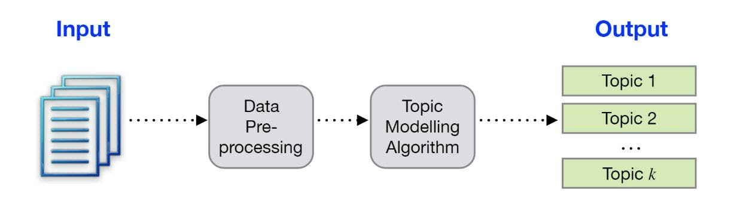
What is Topic Modelling?
Topic Modeling is a type of statistical modeling for discovering the abstract “topics” that occur in a collection of documents
It refers to the process of dividing a corpus of documents in two:
A list of the topics covered by the documents in the corpus
Several sets of documents from the corpus grouped by the topics they cover
Unsupervised Model - No labelled data required
Why Topic Modelling?
Quick and easy to implement
Gives good understanding and insights into our data

Slide 7




How does Topic Modelling work?
Topic modeling involves counting words and grouping similar word patterns to infer topics within unstructured data
By detecting patterns such as word frequency and distance between words, a topic model clusters feedback that is similar, and words and expressions that appear most often and thereon quickly deduce what each set of texts are talking about
A software company wants to know what customers are saying about features of your product
Spend hours going through heaps of feedback
Use topic modeling algorithm to deduce that topics the texts are talking about

Slide 8
Latent Semantic Analysis (LSA)
LSA is one of the most frequent topic modeling methods
Based on distributional hypothesis which states that the semantics of words can be grasped by looking at the contexts the words appear in
LSA computes how frequently words occur in the documents – and the whole corpus – and assumes that similar documents will contain approximately the same distribution of word frequencies for certain words
Syntactic information (example: word order) and semantic information (example: the multiplicity of meanings of a given word) are ignored and each document is treated as a bag of words

Slide 9
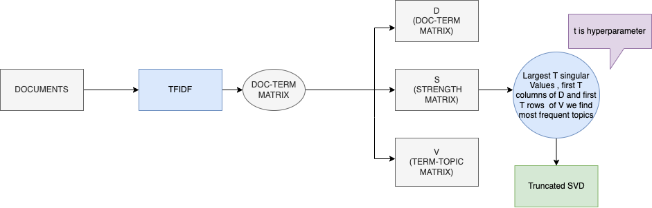
LSA - Steps
Obtain Document term matrix using TF-IDF Vectorization
Decompose this matrix into the product of 3 matrices (USV) by using singular value decomposition (SVD)
Keep the largest t singular values together with the first t columns of U and the first t rows of V, we can obtain the t more frequent topics found in our original Document-term matrix. We call this truncated SVD
To use it for LSA, we set the value of t as a hyperparameter
Use matrices S &D to identify the best results

Slide 10

What is BERT?
BERT or BerTopic is a topic modeling technique that uses transformers (BERT embeddings) and class-based TF-IDF to create dense clusters
Better for contextual analysis, understands the context of the sentence
Why is BERT better than LSA?
1) More interpretable clusters
2) More accurate results
3) More efficient representation

Slide 11
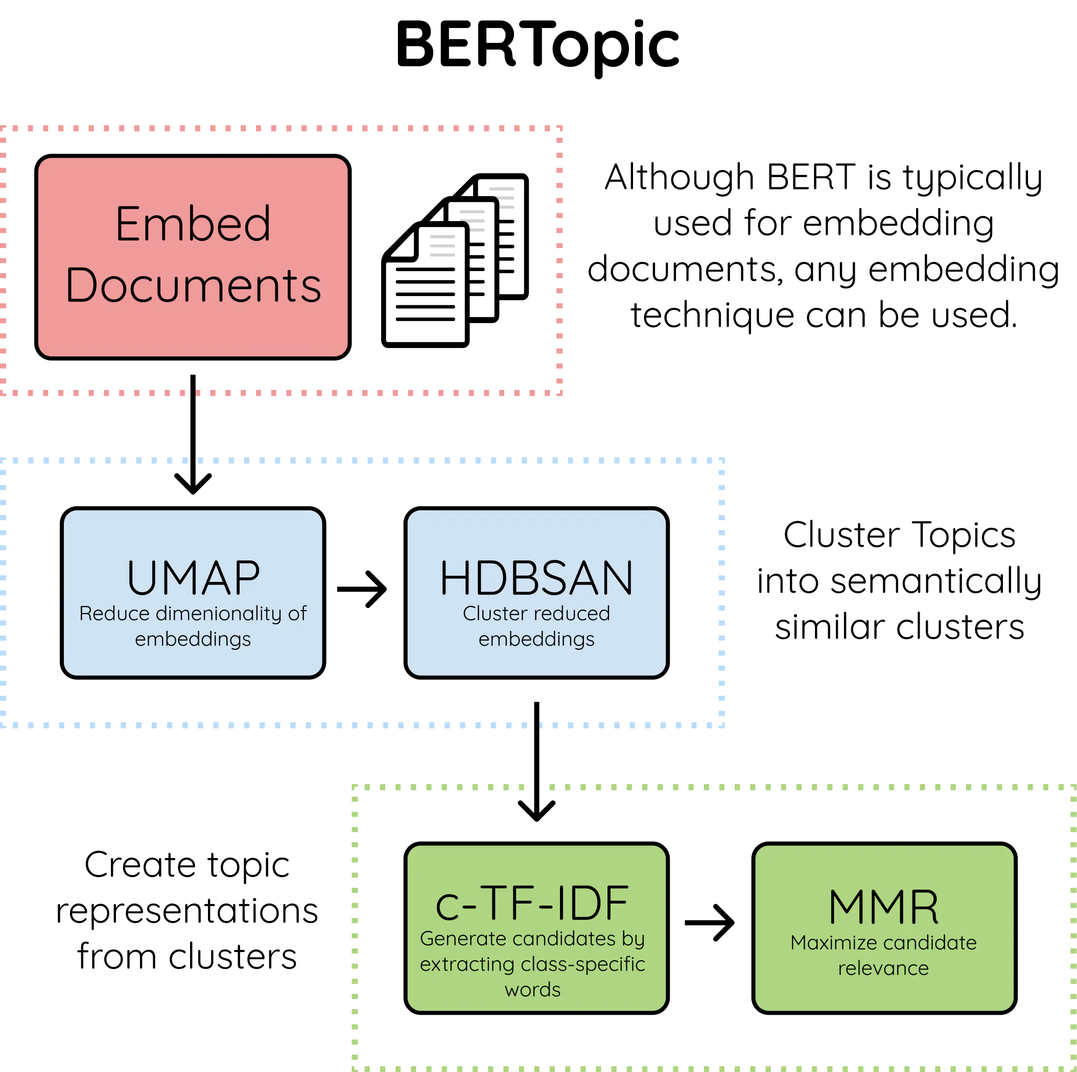
BERT Topic algorithm - Steps
The Bert topic algorithm contains 3 stages :
1. Embed the textual data(documents)
It uses the following sentence transformers
A) paraphrase-MiniLM-L6-v2
B) paraphrase-multilingual-MiniLM-L12-v2
2. Cluster Documents
Uses UMAP to reduce the dimensionality of embeddings and the HDBSCAN technique to cluster reduced embeddings and create clusters of semantically similar documents
3. Create a topic representation
Extract and reduce topics with class-based TF-IDF and the improve the coherence of words with Maximal Marginal Relevance

Slide 12
Approach
Use only reviews after 2014-06-01
Pre-process all the review text (remove stop words, punctuations, digits, lemmatize)
Divide these cleaned reviews into 3 pots:
Less than or equal to Overall Rating 2
Between Overall Rating = 3 and Overall Rating = 4
Overall Rating = 5
This way we can see which topics drives bad, good or excellent ratings
Now run topic models on each of the data pots using :
Latent Semantic Analysis (LSA) (Trigram Approach)
BertTopicModelling (Unigram Approach)

Slide 13

Model findings - LSA
These are the most frequently occurring topics for each of the ratings as per our LSA Topic Model (in order of frequency high to low)
Poor Ratings (1,2)
Book not recommended
Waste of time
Unable to finish book
Wanted and looked forward to the book but end up not liking
Good Ratings (3,4)
Look forward to read more
Honest book exchange
Look forward to book series
Free copy book
Wicked read
Excellent Rating (5)
Highly recommended book
Look forward to more of the book
Can't wait for more book in the series
Great job by the author

Slide 14
Model Findings – BERT Topic
These are the most frequently occurring topics for each of the ratings as per our BERT Topic Model (in order of frequency high to low)
Poor Ratings (1,2)
Not like the story
Cooking, Recipe and food
Ketogenic, calories, crabs and sugar
Average- Good Ratings (3,4)
Love & life
Sex, erotic & hot scenes
Look forward to book Series
War, alien, military, space & science
Grammar, Spellings
Murder, detective, solve , police
Cookbooks, recipe
Paranormal, supernatural, ghost
Diet, healthy
Character, storyline, plot
Child, illustration, animal, pictures, kid
Twist, surprise, turn, unexpected
Short, sweet, love, romantic
Short, story, quick, read
Reading, recommend, author, enjoy
Excellent Rating (5)
Father, mother, heart, life
Plot, storyline, character, development
Twist, turn, surprise , guess
Paranormal, supernatural, ghost, romance
Romantic, sweet, short, cute
Recipe, cook, delicious, ingredients
Laugh, funny, humor, cry, loud
Enjoyable, good, read
Amaze, wow, wait, pace
Page, turner, Takerra
Paleo, diet, recipe, eat, healthy
Marketing, business, medium, social, customer
Illustration, child, kid, rhyme
Goal , motivation, achieve, success
Trade, stock, option
Dog, cat, puppy, animal
Edge, seat, emperor, wait
Gardening, plant
Positive, happiness, thinking
Zombie, apocalypse, dead , survival

Slide 15






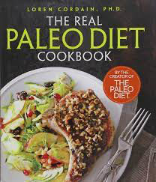
Business Recommendations to Amazon – Topic Modeling
Improve the collection of recipe books, food books as form a large chunk of poor reviews and fair chunk of average reviews and good reviews
Potentially remove unpopular authors or cuisines
Ketogenic books talking about carbs, calories and sugar not a popular choice on Kindle, can remove them
Focus on books that are part of a series, belong to a very likeable author or is trending over the internet
Market, promote and recommend the books in the following categories most :
1) Book about love, life and family
2) Books with good storyline and character development, maybe popular Fiction Books.
3) Books that offer twist, turns and surprises – thrillers
4) Paranormal, supernatural and ghost-themed books
5) Romantic books which are short, sweet and cute
6) Books which have humor and are fun to read
7) Well-paced books
8) Page Turner books
9) Books by Takerra Allen
10) Paleo Diet Books
11) Books that talks about markets, business & customers 12) Books for children consisting of rhymes and illustrations
13) Self-help books that talk about motivation, success and achievements
14) Books talking about stocks, trading and options
15) Animal books focusing on cats or dogs
16) Gardening books
17) Self-help books about positivity in life

Slide 16
SENTIMENT ANALYSIS

Slide 17

Sentiment Analysis – What, Why & Where?
WHAT?
Sentiment analysis is the process of detecting positive or negative sentiment in text. It’s often used by businesses to detect sentiment in social data, gauge brand reputation, and understand customers
There are multiple types of sentiment analysis:
Graded Sentiment Analysis
Emotion Detection
Aspect-based Sentiment Analysis
Multi-lingual sentiment analysis
WHY?
With the advent of social media, humans have begun expressing their thoughts and feelings more widely than ever before, and sentiment analysis can be essential to monitor and understand sentiment in all types of data
From a business standpoint, analyzing customer feedback allows brands to learn customer response better at different stages of marketing, sales and product lifecycle. This in turn helps the businesses tailor products and services to meet the needs of the customer.
WHERE?
Text data is extensively available today, including social media, reviews (product, movie, services), etc.,
In this project, we perform graded sentiment analysis (binary and multi-class), with the intent to estimate customer review sentiment and generate insights to drive business decisions

Slide 18
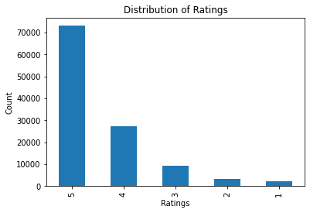
Approach towards Sentiment Analysis
Given that the reviews all have corresponding ratings, Supervised machine learning techniques have been employed to classify the text. We have adopted the below methodologies to implement this
Binary Classification
Positive : Rating 4,5
Negative : Rating 1,2
Rating 3 is excluded for this analysis
Multi-class Classification
Positive : Rating 4,5
Negative : Rating 1,2
Neutral : Rating 3
Modeling Techniques
Multinomial Naïve Bayes' Classification
Logistic Regression
Deep learning neural network (NN)
Simple Recurring NN (RNN)
Long short-term memory (LSTM)
1-dimensional Convolutional NN (CNN)

Slide 19
Text pre-processing
Removing Stopwords
Created a custom stopwords list
Regex Cleaning
Removed punctuations, special characters, extra white spaces, URLs
Upsampling
Up-sampled the data by resampling labels for the imbalanced class
Train-Test Split
Split data in 70:30 train-test ratio
Word Embeddings
Generated custom word embeddings for the tokenized words in the dataset
Vectorization
Count-Vectorizer, TF-IDF, Word2Vec and N-grams [(1,1),(2,2)]

Slide 20
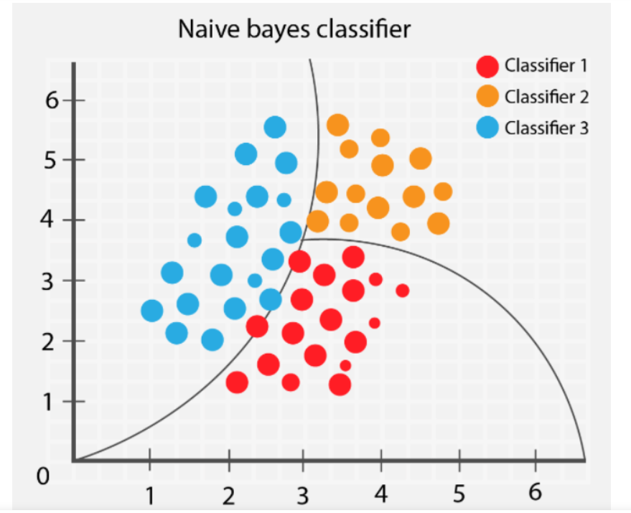
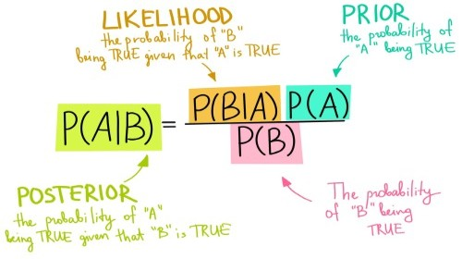
Multinomial Naïve Bayes' Classification
Multinomial Naive Bayes algorithm is a probabilistic learning method based on the Bayes theorem
It predicts the tag of a text by calculating the probability of each tag in the sample and then returns the tag with the highest probability
We have used this as a baseline model since it is simple and easy to implement

Slide 21
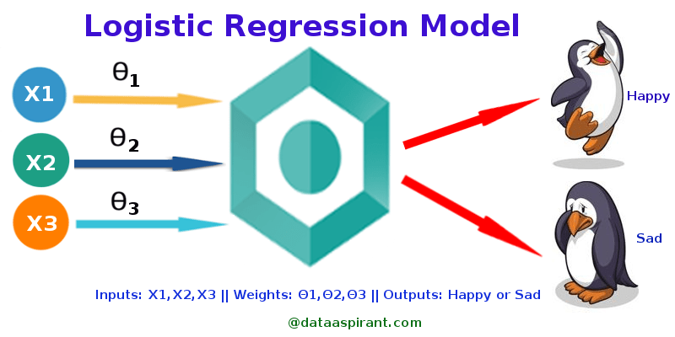
Logistic Regression
This method is used for classification and models the probability of response variable given independent variables using a logistic function
We use both binary and multiple logistic regression models in our analysis
Multinomial logistic regression (MLR) is an extension of logistic regression that adds native support for multi-class classification problems.
Although it is a binary classification model by default, extensions like one-vs-rest can allow logistic regression to be used for multi-class classification problems
changing In MLR, the loss function is replaced by cross-entropy loss and multinomial probability distribution is used

Slide 22
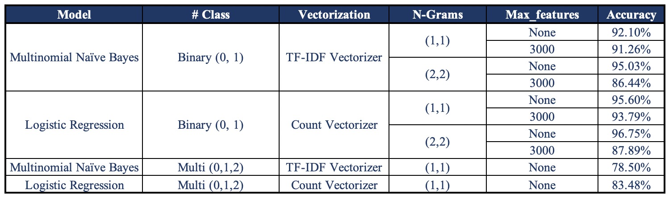
Baseline Model Results
Baseline Models
Naive Bayes
Binary
Logistic Regression
Binary
Multi-class
Multi-class
Binary
Confusion
Matrix
Given the model performance results, we see high classification error for multi-class models.
As we proceed to advanced techniques, we decided to limit out analysis to binary sentiment classification.
Multi-
class
Naïve Bayes
Logistic Regression

Slide 23
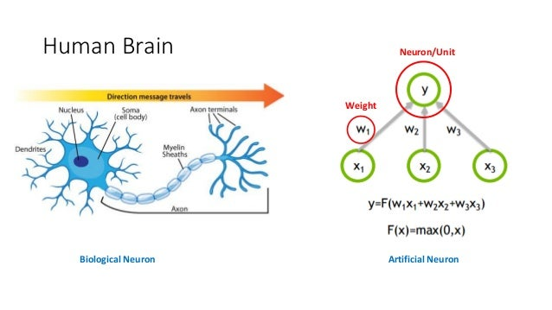
Deep Learning Neural Network
Deep learning is a subset of machine learning, which is essentially a neural network with three or more layers
These neural networks attempt to simulate the behavior of the human brain
Deep neural networks consist of multiple layers of interconnected nodes, each building upon the previous layer to refine and optimize the prediction or categorization, thus increasing prediction accuracy
It uses processes like forward propagation and backpropagation, and minimizes the loss using algorithms like gradient descent to build the model

Slide 24
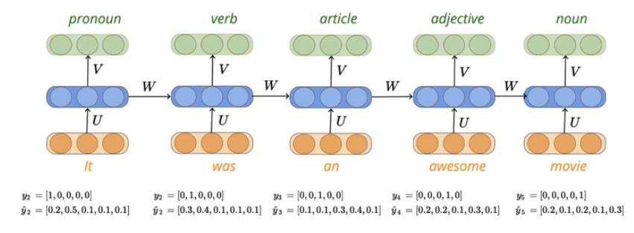
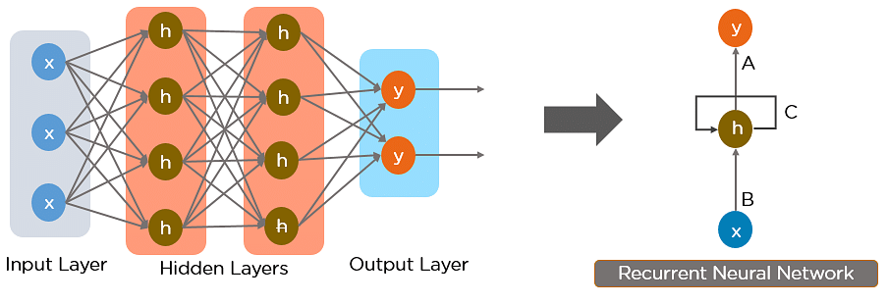
Simple Recurring Neural Network (RNN)
A recurrent neural network (RNN) is a type of artificial neural network which uses sequential data
They are distinguished by their “memory” as they take information from prior inputs to influence the current input and output
While traditional deep neural networks assume that inputs and outputs are independent of each other, the output of RNNs depend on the prior elements within the sequence
Another distinguishing characteristic of RNN is that they share parameters across layers

Slide 25
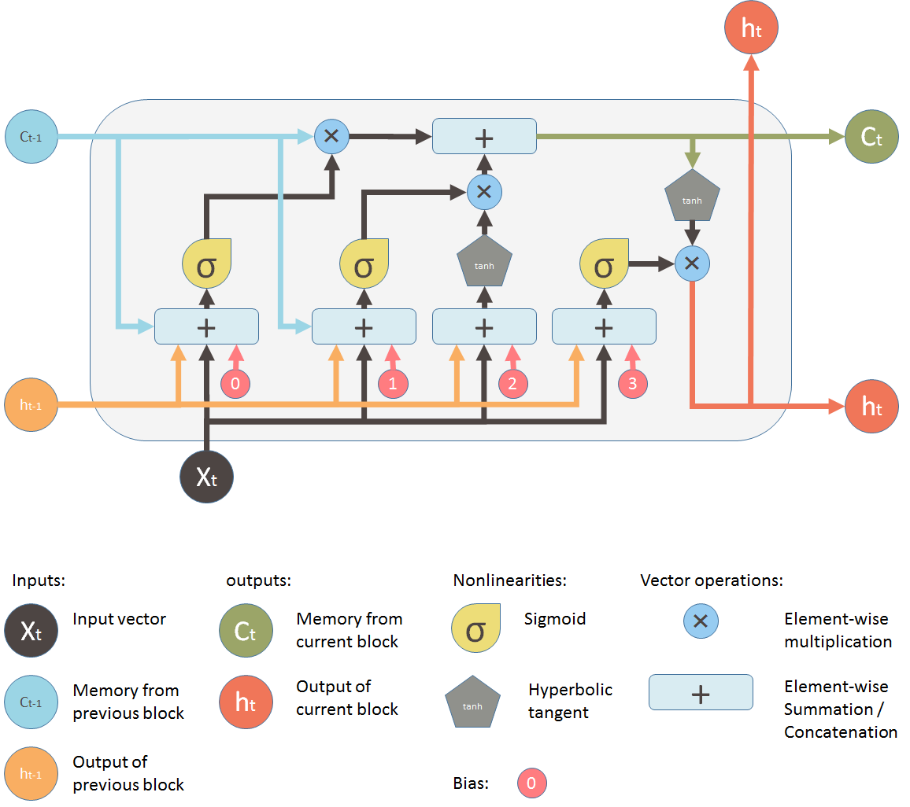
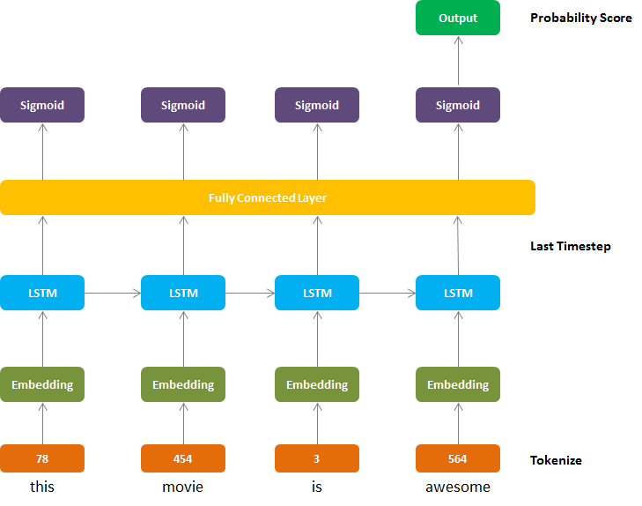
Long short-term memory (LSTM)
Long Short-Term Memory networks – usually just called “LSTMs” – are a special kind of RNN, capable of learning long-term dependencies
A common LSTM unit is composed of a cell, an input gate, an output gate and a forget gate
The cell remembers values over arbitrary time intervals and the three gates regulate the flow of information into and out of the cell
Model Architecture
Illustration

Slide 26
1-Dimensional Convolutional Neural Network (CNN)
CNN is a class of artificial neural network most applied to analyze visual imagery
CNNs use shared-weight architecture of the convolution kernels that slide along input features and provide translation-equivariant responses known as feature maps
CNNs are regularized versions of of multi-layer perceptrons (MLP)
Although CNNs are mainly used for image data, they can also be applied to text data, as text also has adjacency information
Model Architecture Illustration

Slide 27
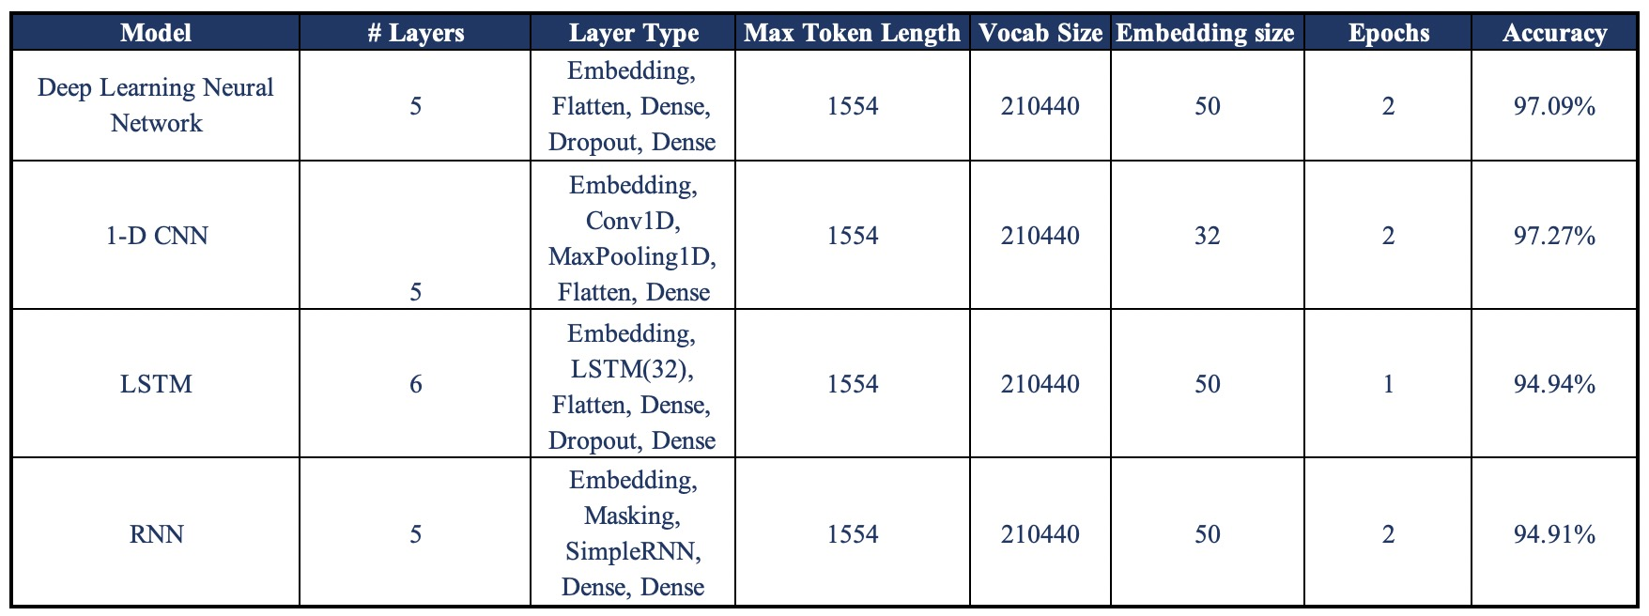
Model Results
In comparison to the baseline models, all neural network models tend to perform better than the best baseline model on the test dataset, achieving high accuracy and precision
Among the NN models, 1-D CNN performs the best on the test data achieving a 97.27% accuracy, closely followed by the deep leaning NN model (97.09% accuracy)

Slide 28


Model Output
“ I enjoy vintage books and movies so I enjoyed reading this book. The plot was unusual. Don't think killing someone in self-defense but leaving the scene and the body without notifying the police or hitting someone in the jaw to knock them out would wash today. Still it was a good read for me. ”
“ The arabian fantasy, slavegirl trained to seduce and submit herself. Not to my taste, too much sex and not very erotic. Kind of mechanical......... “
Original Classification - “Positive”
Prediction Score – 0.9987
Predicted Classification -
Original Classification - “Negative”
Prediction Score – 0.3995
Predicted Classification -

Slide 29

NEXT STEPS

Slide 30

Implementation & Roadmap – Topic Modeling
Facilitate special 'Book Series' launches on the Kindle platform as this will drive interest e.g., Make all the 'Harry Potter books' on kindle
Create a display on the Kindle App to view the books by the Top 10 categories (basis customer ratings) as mentioned in previous slide
Identify which authors are in the news and try to market them. For e.g., if a new book by Roald Dahl is due to come next month, market all previous Roald Dahl books on the kindle platform
Organize 'Kindle exclusive' book launches to attract huge interest from the reading community
Organize 'Kindle Talks' where people discuss what they might have recently read so that more people share their experiences amongst themselves

Slide 31
Implementation & Roadmap – Sentiment Analysis
“people will forget what you said, people will forget what you did, but people will never forget how you made them feel.”
Build an automated data visualization dashboard to regularly monitor reviews. This dashboard can be customized for internal use and for the product owner
Provide the following metrics by product, time, author, etc., to the product owner:
Key level 1 sentiments such as happy, sad, angry
A level 2 sentiment with further sentiment classification for each of the level 1 sentiment
Extend the text analysis to generate summary based on the review, in scenarios where the summary is too short or does not capture the sentiment of the review
Scale the analysis across regions and languages to cater suggestions to a wider audience
Deliver targeted marketing content & offers to reviewers, build a product recommendation system for the end user
Assist product owners providing reviewer demographics and track customer sentiment over time to improve the recommendation system

Slide 32
Return on Investment (ROI)
Cost & Expenditure (Annual)
Fixed Costs:
Employees - 150,000 * (2 analysts + 1 Data Scientist + 1 Manager) * 1 year = $ 0.6M
Infrastructure, Subscription and Software = $ 1M
Floating Costs:
Marketing – $10 coupons * 50,000 * 6 months = $ 3M
Miscellaneous Costs:
Estimated as 15% of total cost = $ 0.3M
Total Cost of implementation:
$ 4.9M
Earnings & Savings (Annual)
Current Amazon Kindle Revenue - ~$500M
Improved recommendation system, scaling across languages:
Sales increase by 5% = 500M * 5% = $ 25M
Topic modeling recommendation for self-published books:
Sales increase by 10% for 15% publisher revenue = 500M * 10% * 15% = $ 7.5M
Marketing impact:
Assuming typical conservative marketing impact of 2% of revenue = 2% * 500 = $ 10M
Total Earnings and Savings:
$ 42.5M
ROI
Revenue – Expenditure = $42.5M – $4.9M = $ ~37.6M annually

Slide 33
POTENTIAL IMPROVEMENTS
Sentiment Analysis
Improve the underlying modeling techniques by performing extensive hyperparameter tuning, cross-validation and perform better pre-processing
Explore other machine learning techniques such as SVM, random forests, etc.,
Assist text analytics with data from other media such as purchase history, user demographics, marketing response & activity
Leverage gloVe and BERT techniques to improve prediction accuracy
Topic Modeling
Explore other techniques like Latent Dirichlet Allocation(LDA) and Non-Negative Matrix factorization(NMF)​
Use 'Topic Reduction' approach to optimize number of topics generated​
Carry out a n-grams approach to the BERTopic Model to see which works best​
Model the data on the entire data with a higher computing power for more representative results
Pre-process the data with finer details to produce more accurate results

Slide 34
CONCLUSION
As avid book readers in the generation of social media, we decided to analyze Amazon Kindle reviews to better understand the readers’ opinions and their key topics of interest
We filtered for reviews from June - July 2014 and implemented data pre-processing techniques on the raw dataset
We explored supervised and unsupervised learning techniques for sentiment analysis and topic modeling respectively
As part of topic modeling, BERTopic modeling generated more interpretable results in the form of specific themes. These themes could point us to the most popular categories in the Kindle ecosystem
As part of Sentiment Analysis, 1-D Convolutional Neural Network (CNN) generated the best classification accuracy of 97.27%
Given these, we would deploy BERTopic modeling and 1-D CNN model to drive our analysis and generate data-driven insights
Advanced NLP techniques like Topic Modeling and Sentiment Analysis can thus, be used to transform the way businesses work. We have implemented these techniques in our analysis and estimated the revenue impact ($ 42.5M annualized) through this process, outlining scope for improvement in the product and customer experience

Slide 35
REFERENCES
https://medium.com/analytics-vidhya/bert-for-topic-modeling-bert-vs-lda-8076e72c602b
https://hackernoon.com/nlp-tutorial-topic-modeling-in-python-with-bertopic-372w35l9
https://medium.com/nanonets/topic-modeling-with-lsa-psla-lda-and-lda2vec-555ff65b0b05
https://maartengr.github.io/BERTopic/api/bertopic.html
https://towardsdatascience.com/sentiment-analysis-using-lstm-step-by-step-50d074f09948
https://towardsdatascience.com/a-beginners-guide-to-sentiment-analysis-in-python-95e354ea84f6
https://machinelearningmastery.com/multinomial-logistic-regression-with-python/
https://medium.com/@jjw92abhi/is-logistic-regression-a-good-multi-class-classifier-ad20fecf1309
https://scikit-learn.org/stable/modules/naive_bayes.html

Slide 36
THANK YOU!

